Slide 1
ECOS03 – Embedded Operational Systems
Rodrigo Maximiano Antunes de Almeida
rmaalmeida@gmail.com
@rmaalmeida
Universidade Federal de Itajubá

Slide 2
Schedule
1 - Introdução à SO e arquitetura de computadores
2 - Ponteiros, structs, Buffer circulares e ponteiros de função
3 - Processos e schedulers (temporização e prioridade)
4 - Acesso ao hardware via software e interrupções
5 - Device drivers e Controladora de drivers
6 - Gestão de tasks e memória em um sistema operacional
7 - Comunicação interprocessos e criação de um softwatchdog system
8 - Visão geral de sistemas operacionais – Introdução; Estruturas de sistemas operacionais.
9 - Processos – Threads; Sincronização de Processos.
10 - Memória – Memória principal; Memória Virtual
11 - Sistema de Arquivos - Estrutura de memória secundária
12 - Sistemas com múltiplos processadores
13 - Segurança

Slide 3
The OS

Slide 4
What is a kernel?

Slide 5
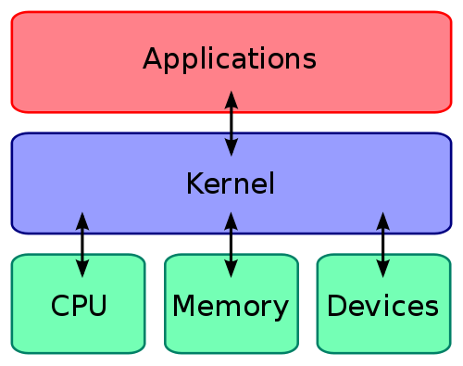
What is a kernel?

Slide 6
What is a kernel?
Kernel tasks:
Manage and coordinate the processes execution using “some criteria”
Manage the free memory and coordinate the processes access to it
Intermediate the communication between the hardware drivers and the processes

Slide 7
What is a kernel?
Interface actions
System logic
Internal routines
C/C++
libraries
GUI
Extra libs
Kernel
Context switch
File system
Drivers
Memory
CPU
I/O

Slide 8
Develop my own kernel?
Why?

Slide 9
Develop my own kernel?
Improve home design
Reuse code more efficiently
Full control over the source
Specific tweeks to the kernel
Faster context switch routine
More control over driver issues (interrupts)

Slide 10
Develop my own kernel?
Why not?

Slide 11
Develop my own kernel?
Kernel overhead (both in time and memory)
Free and paid alternatives
Time intensive project
Continuous development

Slide 12
Kernel Project
Source code size (millions of lines)
FreeBSD – 8.8
IOS – 80
Linux (2.6.0) – 5.2
Linux (3.6) – 15.9
Debian 7.0 – 419
Mac OS X 10.4 – 86
OpenSolaris – 9.7
Windows NT – 11
Windows XP – 45
Windows Vista – 66

Slide 13
Develop my own kernel?
Alternatives
Windows Embedded Compact®
VxWorks®
X RTOS®
uClinux
FreeRTOS
BRTOS

Slide 14
Electronic building
Electronics review
Schematics
Datasheets
Protoboard/breadboard
LED
Potentiometer
LCD
Microcontroller
System design
Basic steps

Slide 15
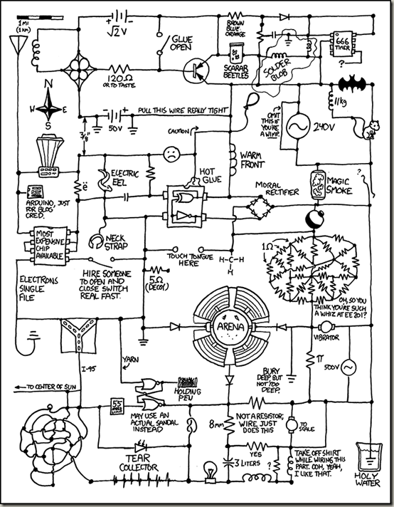
Electronics review
http://xkcd.com/730/

Slide 16
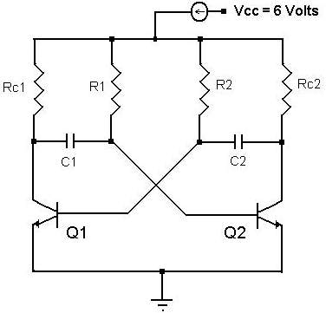
Schematics
Way to represent the components and its connections
Each component has its own symbol
Crossing wires only are connected if joined with a dot

Slide 17
Circuits 101
Voltage, current, resitance

Slide 18
Advanced components

Slide 19
Datasheets
The main source of information concerning electronics
Presents
Electrical characteristics
Simplified schematics
Use example
Opcodes/API

Slide 20
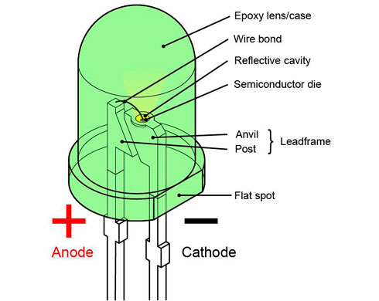
LED

Slide 21
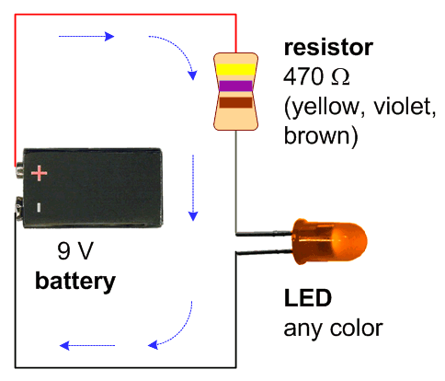
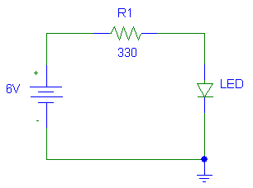
LED

Slide 22
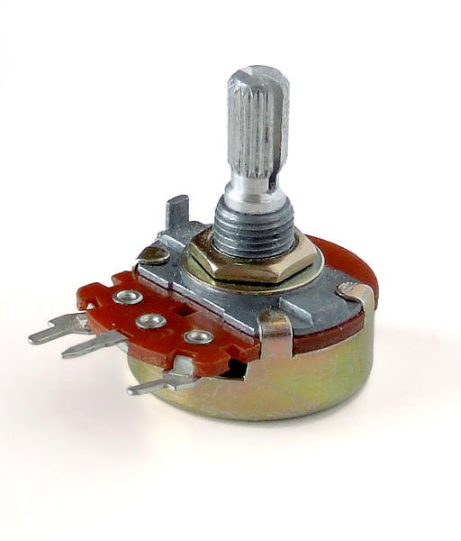
Potentiometer
Linear/Log
Used as voltage divisor
Need an analog input
Filter

Slide 23
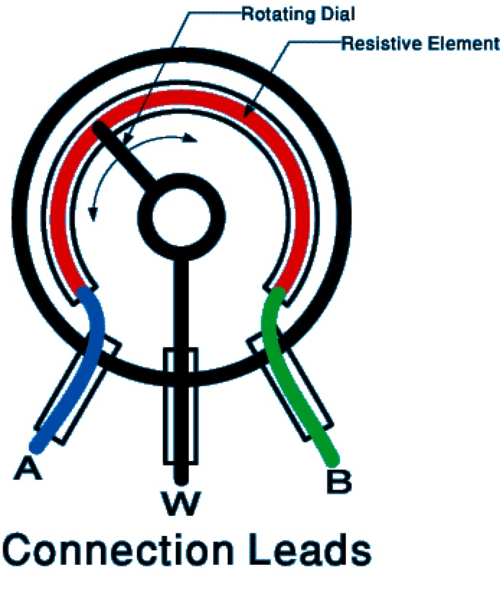
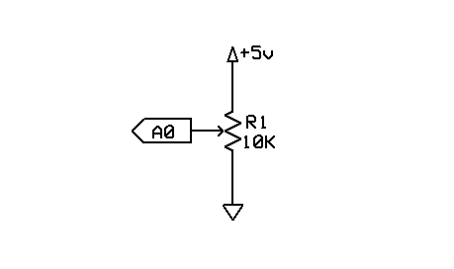
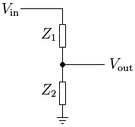
Potentiometer

Slide 24
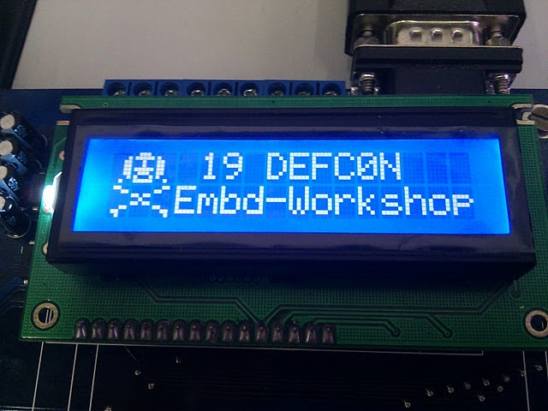
LCD Display

Slide 25
LCD Display
Complete interface solution
Screen + Video card + Protocol + Data cable
“Standart” HD44780
4/8 bits communication
3 control bits

Slide 26
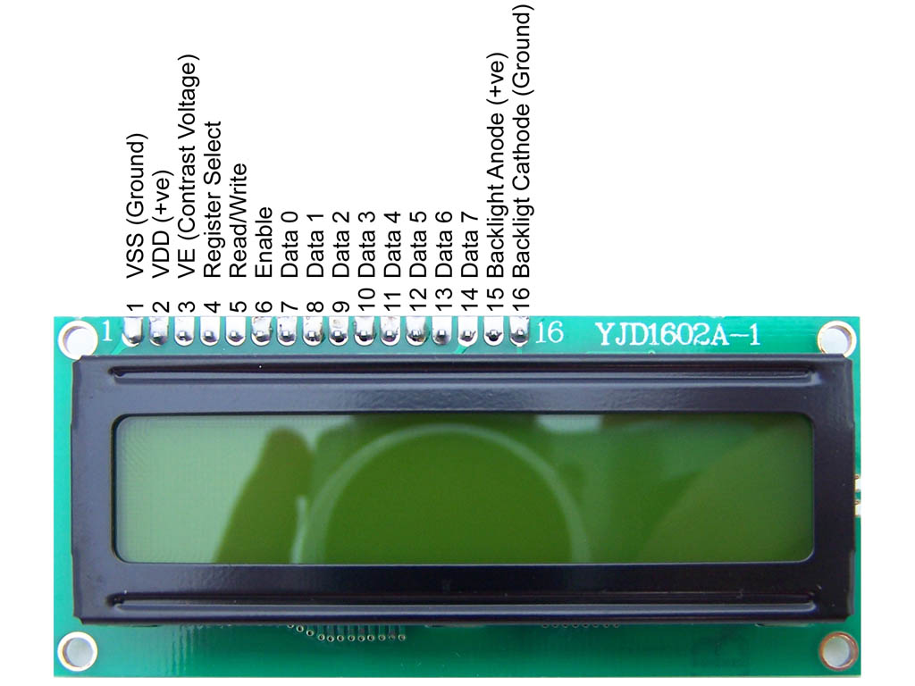
LCD Display

Slide 27
LCD Display
Data connection
Backlite
Current consumption
Power on time/routine

Slide 28
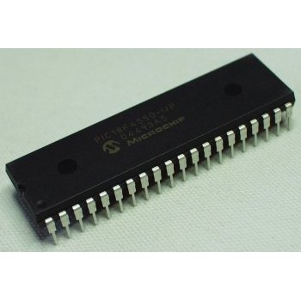
Microcontroller
System-on-a-chip
Processor
Memory
Input/Output peripherals
Communication
Safety components

Slide 29
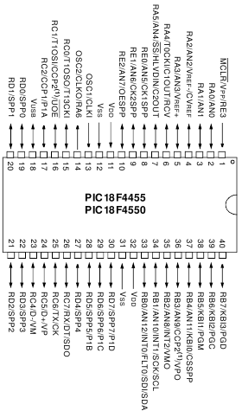
Microcontroller
Xtal configuration
Reset pin
DC needs
Many peripherals on the same pin

Slide 30
System design
Steps on a generic electronic system design
Define the objective(s)
Choose the main components needed to achieve the objective
Get the use example and recommendations from component datasheet
Build the schematics
Simulation of HW elements
Board layout

Slide 31
System design
Cad tool: KiCAD

Slide 32
Programming 101
Embedded Tools

Slide 33
Board programming
Programmer
IDE
Basic concepts
CPU Architecture
HW configuration
Memory access
First program (He110 DEFC0N)
Peripheral setup
Second program (ADC read)

Slide 34
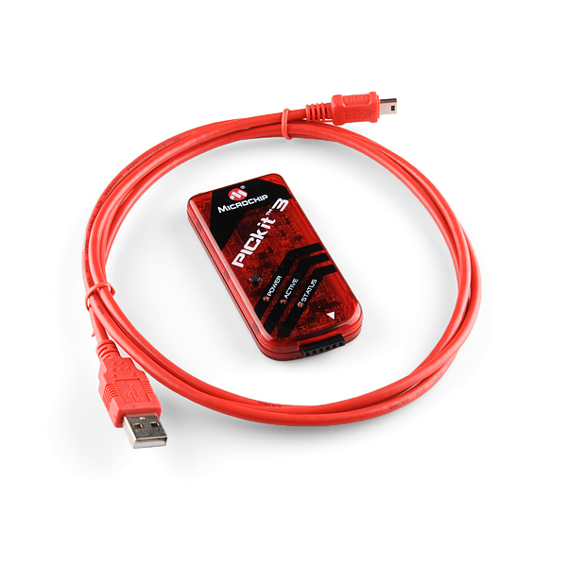
Board programming
Programmer
PICkit3
Can use ICSP
Can program a lot of Microchip products
Also a debugger

Slide 35
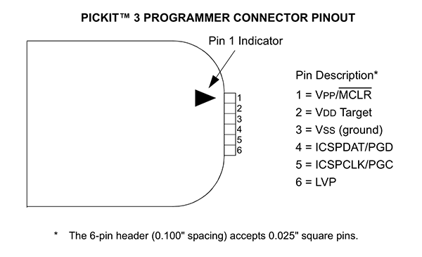
Board programming

Slide 36

Board programming
IDE
MPLABX
Based on Netbeans
Compiler
XC8

Slide 37
Processor architecture

Slide 38
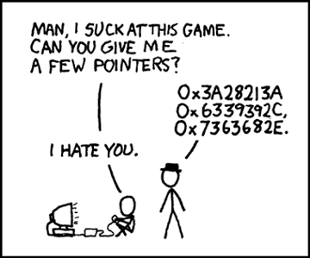
1. Pointers
https://xkcd.com/138/

Slide 39
Pointers
They are variables that store the address (location) of memory.
In these memory addresses it is possible to enter values.
The type of the value placed in the memory pointed by the address is defined in the declaration of the pointer.
The type that tells the compiler how much memory is needed to store the values.
A pointer variable points to a variable of a certain type (char, int, float, double, ...).

Slide 40
Pointers
It is necessary in the declaration of a pointer, to specify for which type of variable it will point.
Pointers are declared with a * before the variable name.
Sintax:
type *variableName;

Slide 41
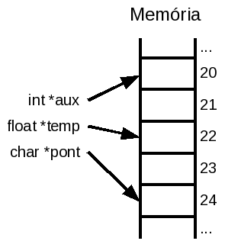
Pointers
int *aux;
float *temp;
char *pont;
aux, temp, and pont are variables that store memory addresses and not variable of the types int, float, or char.
* is used when you want to access the value that is in the memory location and not the memory address.

Slide 42

Pointers

Slide 43
Pointers
Operator &:
Always gets the address of a variable
Since pointers are also variables, they also occupy memory.
You can get the pointer address and have pointers to pointers (multiples *).
Operator *:
The * operator does the opposite of the & operator.
Given a pointer, the * operator accesses the content pointed to by it.

Slide 44
Pointers
Operator &:
“get the address of”
“saved in”
Operator *:
“dereference”
“through”
“pointed by”

Slide 45
Pointers
#include <stdio.h>
int main(int argc, char *argv[]){
int x=10;
int *p1=&x; //ponteiro para um inteiro
printf("x = %d\n\n", x);
*p1=20; //ou p1[0]=20;
printf("p1 = %u\n", p1);
printf("x = %d\n", x);
printf("*p1 = %d\n", *p1);
printf("p1[0] = %d\n\n", p1[0]);
return 0;
} //end main

Slide 46
Parameter passing
C-language functions can receive multiple parameters and can return one.
The method of sending the parameters can be done through the stack or through registers.
The stack allows several parameters to be passed at once
The registers have a lower overhead, therefore being faster and with smaller code size

Slide 47
Parameter passing
When sending, the parameters are copied to a temporary variable, so that changes in its value are lost after the end of the function.
The initial variable is not changed
To avoid this situation it is common to pass the parameter by reference.
When passing by reference, the address of the variable is passed instead the value. Therefore the function can change the value of the original variable.

Slide 48
Parameter passing
void incrementa(int a){
a += 1;
}
int main(int argc, char *argv[]){
int x = 10;
incrementa(x);
return 0;
}

Slide 49
Rotina Principal
Função
void main(void){
int x = 10;
incrementa(x);
return 0;
}
void incrementa(int a){
a+=1;
return;
}

Slide 50
Rotina Principal
Função
Variáveis
void main(void)
{
int x = 10;
inc(x);
return 0;
}
void inc(int a){
a += 1;
return;
}
x=10

Slide 51
Rotina Principal
Função
Variáveis
void main(void)
{
int x = 10;
inc(x);
return 0;
}
void inc(int a){
a += 1;
return;
}
x=10
temp=10

Slide 52
Rotina Principal
Função
Variáveis
void main(void)
{
int x = 10;
inc(x);
return 0;
}
void inc(int a){
a += 1;
return;
}
x=10
a=10

Slide 53
Rotina Principal
Função
Variáveis
void main(void)
{
int x = 10;
inc(x);
return 0;
}
void inc(int a){
a += 1;
return;
}
x=10
a=11

Slide 54
Rotina Principal
Função
Variáveis
void main(void)
{
int x = 10;
inc(x);
return 0;
}
void inc(int a){
a += 1;
return;
}
x=10
descartado

Slide 55
void incrementaptr(int* a){
(*a) += 1;
}
int main(int argc, char *argv[]){
int x = 10;
incrementaptr(&x);
return 0;
} //end main

Slide 56
Rotina Principal
Função
Variáveis
void main(void)
{
int x = 10;
incptr(&x);
return 0;
}
void incptr
(int* a){
(*a) += 1;
return;
}
x=10

Slide 57
Rotina Principal
Função
Variáveis
void main(void)
{
int x = 10;
incptr(&x);
return 0;
}
void incptr
(int* a){
(*a) += 1;
return;
}
x=10
temp=&x

Slide 58
Rotina Principal
Função
Variáveis
void main(void)
{
int x = 10;
incptr(&x);
return 0;
}
void incptr
(int* a){
(*a) += 1;
return;
}
x=10
a=&x

Slide 59
Rotina Principal
Função
Variáveis
void main(void)
{
int x = 10;
incptr(&x);
return 0;
}
void incptr
(int* a){
(*a) += 1;
return;
}
x=11
*
a=&x

Slide 60
Rotina Principal
Função
Variáveis
void main(void)
{
int x = 10;
incptr(&x);
return 0;
}
void incptr
(int* a){
(*a) += 1;
return;
}
x=11
descartado

Slide 61
Parameter passing
Passing parameters by reference allows a function to "return" more than one parameter at a time.
This is done by passing a variable via reference so that the function can write to it.

Slide 62
//a e b são dados de entrada
//d e r são dados de saída
void div(int a, int b, int* d, int* r){
(*d) = a / b;
(*r) = a % b;
return;
}
void main(void){
int d, r;
div(10, 3, &d, &r);
//d = 3 e r = 1;
return;
}

Slide 63
2. Struct

Slide 64
Struct
Structs are composed variables.
Group lots of information as if they were one single variable.
A vector that each position stores a different type
// struct declaration
typedef struct{
unsigned short int age;
char name[51];
float weight;
}people;

Slide 65
Struct
void main(void){
people someone = {26, "Name", 70.5};
someone.age = 27;
//using each variable from the struct
printf("Age: %d\n", someone.age);
printf("Name: %s\n", someone.name);
printf("Weight: %f\n", someone.weight);
return 0;
}

Slide 66
Struct
typedef struct{
char nome[20];
int idade;
int *p_dado;
}t_aluno;
t_aluno *a1;
(*a1).idade = 18;
a1->idade = 18;
The access of the internal members of structures, pointed by pointers, can actually be done through the operator ->

Slide 67
Struct
void main(void){
int dado = 10;
t_aluno aluno = {"Nome",17,&dado};
t_aluno *a1;
a1 = &aluno;
(*a1).idade = 18;
printf("Age: %d\n", (*a1).idade);
a1->idade = 19;
printf("Age: %d\n", a1->idade);
*(aluno.p_dado) = 11;
printf("dado: %d\n", dado);
//aluno->p_dado = 12; //erro
//printf("dado: %d\n", dado);
*((*a1).p_dado) = 12;
printf("dado: %d\n", dado);
*(a1->p_dado) = 13;
printf("dado: %d\n", dado);
return 0;
}

Slide 68
3. Circular buffers

Slide 69
Circular Buffers
“Endless” memory spaces
Use FIFO aproach
Store temporary data
Can implemented using vectors or linked-lists

Slide 70
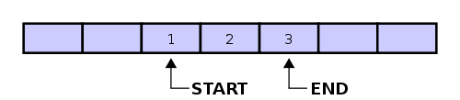
Circular Buffers
Vector implementation
Uses less space
Need special caution when cycling
Problem to differentiate full from empty

Slide 71
Circular Buffers
[0]
[1]
[2]
[3]
[4]

Slide 72
Empty buffer
start=0
?
?
?
?
?
[0]
[1]
[2]
[3]
[4]
end=0

Slide 73
Adding 2 elements
start=0
A
B
?
?
?
[0]
[1]
[2]
[3]
[4]
end=2

Slide 74
Removing 1 element
start=1
A
B
?
?
?
[0]
[1]
[2]
[3]
[4]
end=2

Slide 75
Adding 2 elements
start=1
A
B
C
D
?
[0]
[1]
[2]
[3]
[4]
end=4

Slide 76
Adding 1 element
start=1
A
B
C
D
E
[0]
[1]
[2]
[3]
[4]
end=0

Slide 77
Circular buffers
#define CB_SIZE 10
int circular_buffer[CB_SIZE];
int index=0;
for(;;){
//do anything with the buffer
circular_buffer[index] = index;
//increment the index
index = (index+1)%CB_SIZE;
}

Slide 78
Circular buffers
#define CB_SIZE 10
int circular_buffer[CB_SIZE];
int start=0, end=0;
char AddBuff(int newData)
{
//check if there is space to add a number
if ( ((end+1)%CB_SIZE) != start)
{
circular_buffer[end] = newData;
end = (end+1)%CB_SIZE;
return SUCCESS;
}
return FAIL;
}

Slide 79
Exercise
Implement a circular buffer
Use a 10-position vector
Each element of the vector is a structure with two variables
char * ProcessName;
int Time;
Create one function to add new elements and one to remove the oldest elements.

Slide 80
Exercise
//definição da estrutura
typedef struct {
char* nome;
int time;
}process;
//definição do buffer circular
#define BUFFERSIZE 10
process buffer[BUFFERSIZE];
//definição dos “ponteiros” de acesso
int start, end;

Slide 81
Exercise
//função de adição de “process” no buffer
void addProc(char *nnome, int ntime){
//checagem de espaço disponível
if ( ((end+1)%BUFFERSIZE) != start){
//Atualização da posição atual
buffer[end].nome = nnome;
buffer[end].time = ntime;
//incremento da posição
end = (end+1)%(BUFFERSIZE);
}
}

Slide 82
Exercise
//função de remoção de um “process” do buffer
void removeProc (void){
//checagem se existe alguem pra retirar
if (end != start){
//incremento da posição
start = (start +1)%(BUFFERSIZE);
}
}

Slide 83
Exercise
#include "stdio.h"
void main (void){
addProc("proc1", 0);
addProc("proc2", 1);
addProc("proc3", 2);
removeProc();
removeProc();
removeProc();
}

Slide 84
4. Function pointers

Slide 85
Problem
How to execute a function that is not known at compile time?
Know the address of the function at runtime.
Stack the parameters correctly that the function needs
Make a function call to this address

Slide 86
Function pointers
Work almost as a normal pointer
Its manipulation obeys all pointer manipulation rules.
Hold the address of a function start point instead the address of a variable
The compiler need no known the function signature to pass the correct parameters and the return value.
Awkard declaration (it is best to use a typedef)

Slide 87
Function pointers
//defining the type pointerTest
//it is a pointer to function that:
// receives no parameter
// returns no parameter
typedef void (*pointerTest)(void);
//Function to be called
void nop (void){ __asm NOP __endasm }
//creating an pointerTest variable;
pointerTest foo;
foo = nop;
(*foo)(); //calling the function via pointer

Slide 88
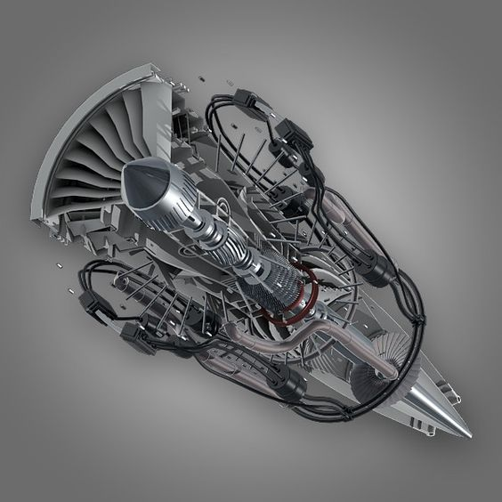
Software engines

Slide 89

Software engines
Necessity:
Make an image editor that can choose the right function to call
1st Implementation
Use a option parameter as a switch operator

Slide 90
Software engines
image Blur(image nImg){}
image Sharpen(image nImg){}
image imageEditorEngine(image nImg, int opt){
image temp;
switch(opt){
case 1:
temp = Sharpen(nImg);
break;
case 2:
temp = Blur(nImg);
break;
}
return temp;
}

Slide 91
Soft.Eng. v2
Re-code the image editor engine using function pointers

Slide 92
Function pointers
image Blur(image nImg){}
image Sharpen(image nImg){}
typedef image (*ptrFunc)(image nImg);
//image editor engine
image imageEditorEngine(ptrFunc function,
image nImg){
image temp;
temp = (*function)(nImg);
return temp;
}

Slide 93
Function pointers
Good
New function additions do not alter the engine
The engine only needs to be tested once
Can change the function implementations dynamically
Bad
More complex code (function pointers are not easy to understand for beginners)
Probable bugs
Lack of compile time guarantees (function signature)
Problems with branch predictor

Slide 94
Exercise
Using function pointers

